Slide 1
2D Transformations with Matrices

Slide 2
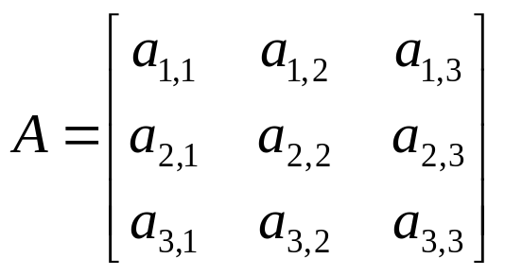
Matrices
A matrix is a rectangular array of numbers.
A general matrix will be represented by an upper-case italicised letter.
The element on the ith row and jth column is denoted by a_{i,j}. Note that we start indexing at 1, whereas C indexes arrays from 0.

Slide 3

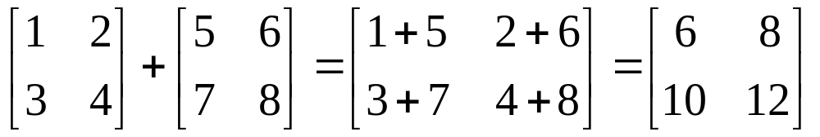
Matrices – Addition
Given two matrices A and B if we want to add B to A (that is form A+B) then if A is (n×m), B must be (n×m), Otherwise, A+B is not defined.
The addition produces a result, C = A+B, with elements:

Slide 4
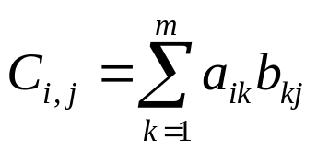
Matrices – Multiplication
Given two matrices A and B if we want to multiply B by A (that is form AB) then if A is (n×m), B must be (m×p), i.e., the number of columns in A must be equal to the number of rows in B. Otherwise, AB is not defined.
The multiplication produces a result, C = AB, with elements:
(Basically we multiply the first row of A with the first column of B and put this in the c_{1,1} element of C. And so on…).

Slide 5
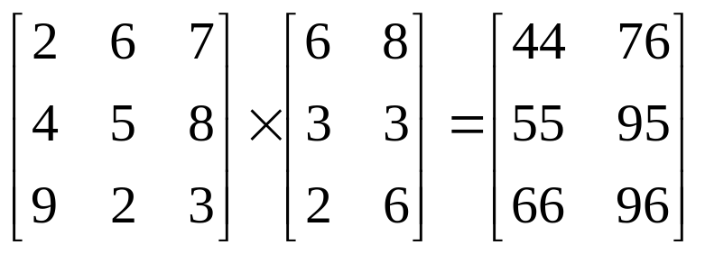
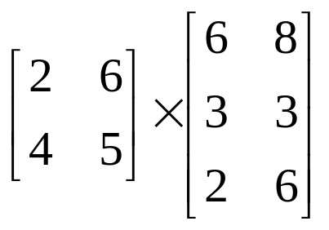
Matrices – Multiplication (Examples)
2×6+ 6×3+ 7×2=44
Undefined!
2x2 x 3x2 2!=3
2x2 x 2x4 x 4x4 is allowed. Result is 2x4 matrix

Slide 6
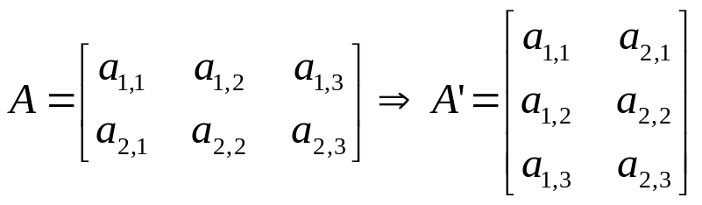
Matrices -- Basics
Unlike scalar multiplication, AB ≠ BA
Matrix multiplication distributes over addition:
A(B+C) = AB + AC
Identity matrix for multiplication is defined as I.
The transpose of a matrix, A, is either denoted A^{T} or A’ is obtained by swapping the rows and columns of A:

Slide 7
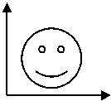
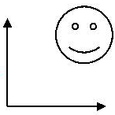
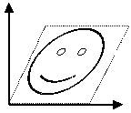
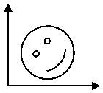
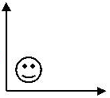
2D Geometrical Transformations
Translate
Shear
Rotate
Scale

Slide 8
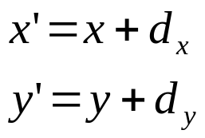
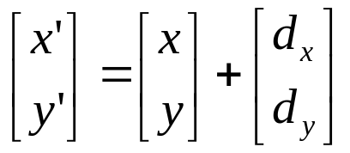
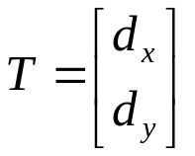
Translate Points
Recall.. We can translate points in the (x, y) plane to new positions by adding translation amounts to the coordinates of the points. For each point P(x, y) to be moved by d_{x} units parallel to the x axis and by d_{y} units parallel to the y axis, to the new point P’(x’, y’ ). The translation has the following form:
P’(x’,y’)
d_{y}
P(x,y)
d_{x}
In matrix format:
If we define the translation matrix , then we have P’ =P + T.

Slide 9
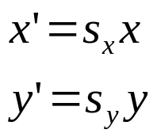
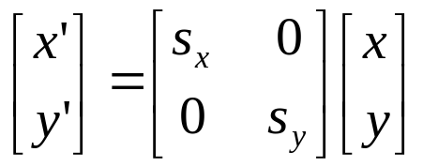
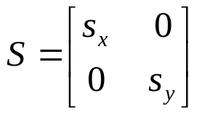
Scale Points
Points can be scaled (stretched) by s_{x} along the x axis and by s_{y} along the y axis into the new points by the multiplications:
We can specify how much bigger or smaller by means of a “scale factor”
To double the size of an object we use a scale factor of 2, to half the size of an obejct we use a scale factor of 0.5
y
P(x,y)
s_{y}• y
P’(x’,y’)
s_{x}• x
x
If we define , then we have P’ =SP

Slide 10
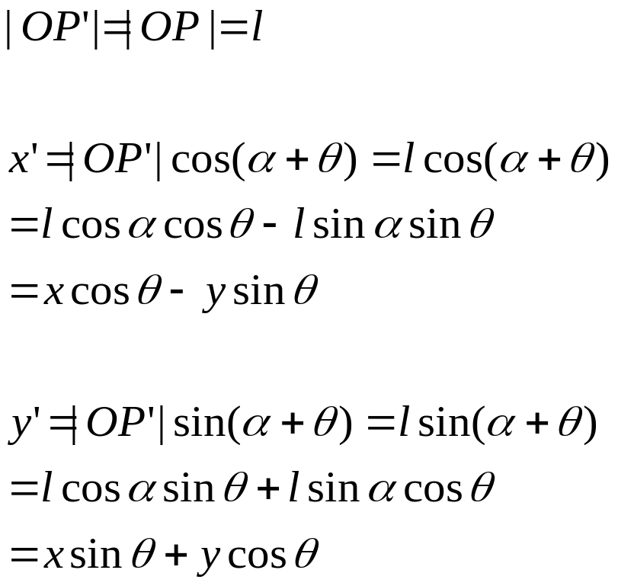
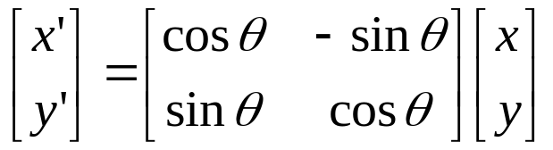
Rotate Points (cont.)
Points can be rotated through an angle θ about the origin:
P’(x’,y’)
y
P(x,y)
l
y’
θ
α
O
x’
x
P’ =RP

Slide 11
Review…
Translate: P’ = P+T
Scale: P’ = SP
Rotate: P’ = RP
Spot the odd one out…
  Multiplying versus adding matrix…
  Ideally, all transformations would be the same..
    easier to code
Solution: Homogeneous Coordinates

Slide 12
Homogeneous Coordinates
For a given 2D coordinates (x, y), we introduce a third dimension:
[x, y, 1]
In general, a homogeneous coordinates for a 2D point has the form:
[x, y, W]
Two homogeneous coordinates [x, y, W] and [x’, y’, W’] are said to be of the same (or equivalent) if
x = kx’ eg: [2, 3, 6] = [4, 6, 12]
y = ky’ for some k ≠ 0 where k=2
W = kW’
Therefore any [x, y, W] can be normalised by dividing each element by W:
[x/W, y/W, 1]

Slide 13
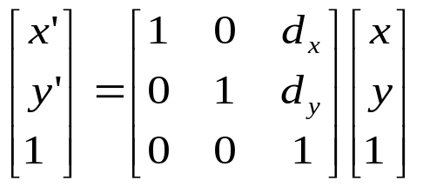

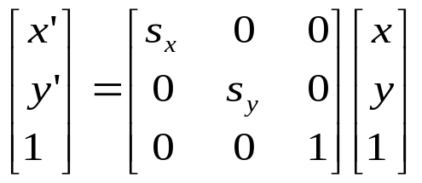
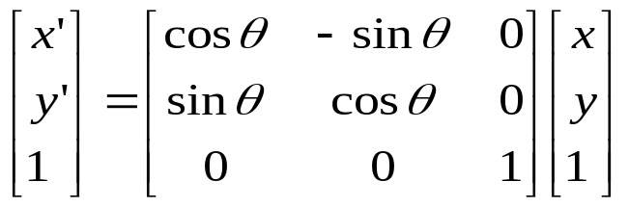
Homogeneous Transformations
Now, redefine the translation by using homogeneous coordinates:
Similarly, we have:
Scaling
Rotation
P’ = S × P
P’ = R × P

Slide 14

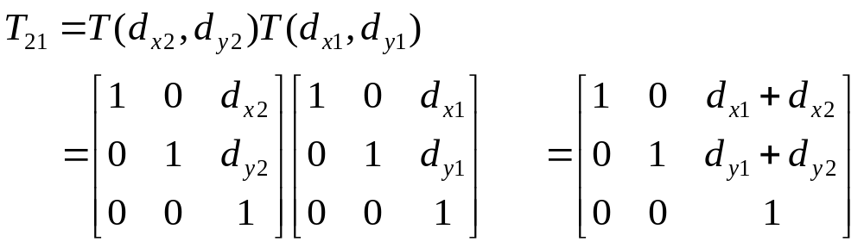
Composition of 2D Transformations
Additivity of successive translations
We want to translate a point P to P’ by T(d_{x1}, d_{y1}) and then to P’’ by another T(d_{x2}, d_{y2})
On the other hand, we can define T₂₁= T(d_{x1}, d_{y1}) T(d_{x2}, d_{y2}) first, then apply T₂₁ to P:
where

Slide 15
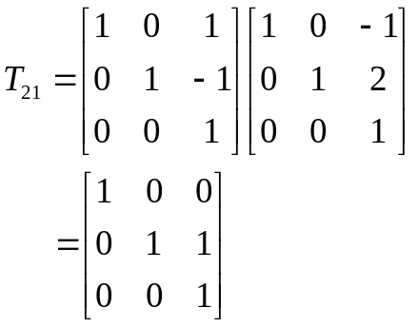
Examples of Composite 2D Transformations
(1,3)
T(-1,2)
T(1,-1)
(2,2)
(2,1)

Slide 16
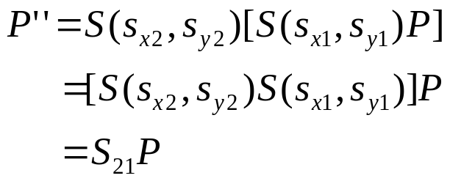
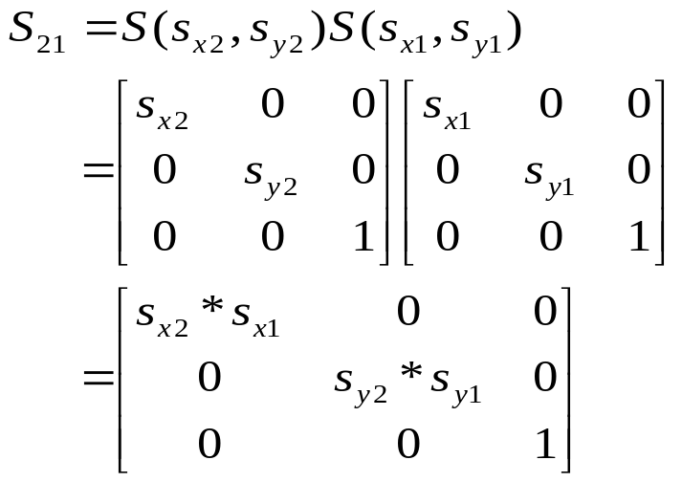
Composition of 2D Transformations (cont.)
Multiplicativity of successive scalings
where

Slide 17
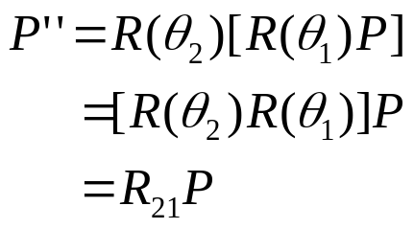
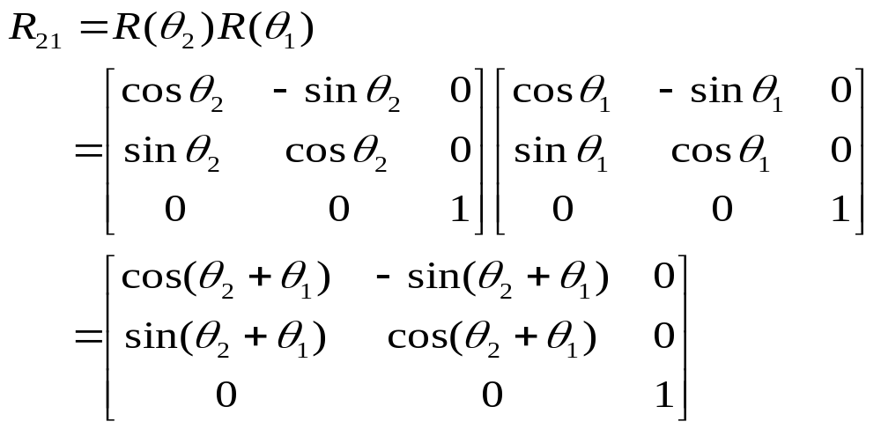
Composition of 2D Transformations (cont.)
3. Additivity of successive rotations
where

Slide 18
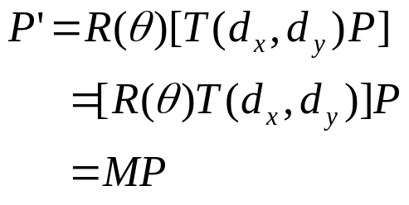

Composition of 2D Transformations (cont.)
4. Different types of elementary transformations discussed above can be concatenated as well.
where

Slide 19
Consider the following two questions:
translate a line segment P₁ P₂, say, by -1 units in the x direction and -2 units in the y direction.
2). Rotate a line segment P₁ P₂, say by θ degrees counter clockwise, about P₁.
P₂(3,3)
P₁(1,2)
P’₂
P’₁
P’₂
P₂(3,3)
θ
P₁(1,2)
P’₁

Slide 20
Other Than Point Transformations…
Translate Lines: translate both endpoints, then join them.
Scale or Rotate Lines: More complex. For example, consider to rotate an arbitrary line about a point P₁, three steps are needed:
1). Translate such that P₁ is at the origin;
2). Rotate;
3). Translate such that the point at the origin returns to P₁.
P₂(3,3)
P₂
T(-1,-2)
R(θ)
P₂
T(1,2)
P₂(2,1)
P₁
P₁(1,2)
θ
P₁
P₁

Slide 21
Another Example.
Translate
Translate
Rotate
Scale

Slide 22
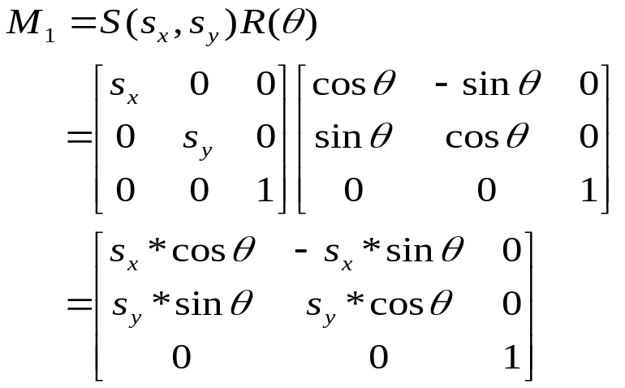
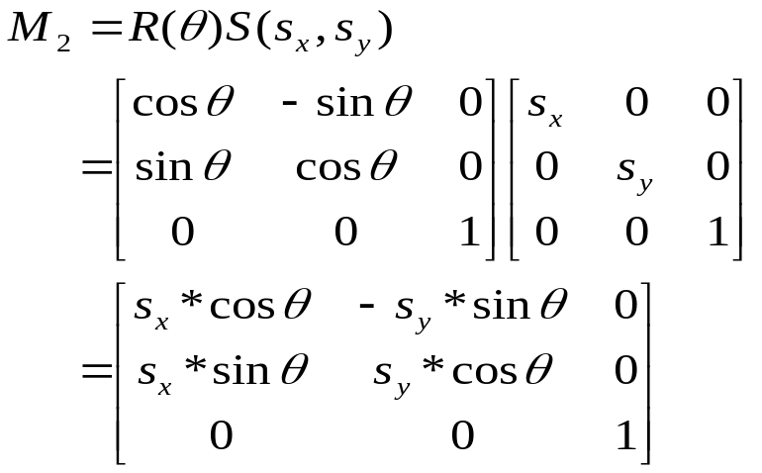
Order Matters!
As we said, the order for composition of 2D geometrical transformations matters, because, in general, matrix multiplication is not commutative. However, it is easy to show that, in the following four cases, commutativity holds:
1). Translation + Translation
2). Scaling + Scaling
3). Rotation + Rotation
4). Scaling (with s_{x} = s_{y}) + Rotation
just to verify case 4:
if s_{x} = s_{y}, M₁ = M₂.

Slide 23
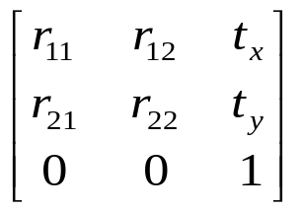
Rigid-Body vs. Affine Transformations
A transformation matrix of the form
where the upper 2×2 sub-matrix is orthogonal, preserves angles and lengths. Such transforms are called rigid-body transformations, because the body or object being transformed is not distorted in any way. An arbitrary sequence of rotation and translation matrices creates a matrix of this form.
The product of an arbitrary sequence of rotation, translations, and scale matrices will cause an affine transformation, which have the property of preserving parallelism of lines, but not of lengths and angles.

Slide 24
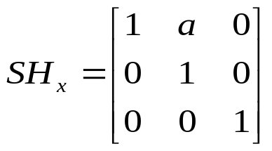
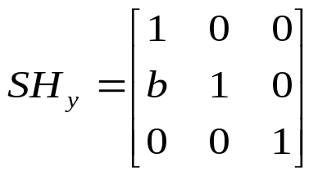
Rigid-Body vs. Affine Transformations (cont.)
Rigid- body
Transformation
Affine
Transformation
Unit cube
45º
Scale in x, not in y
Shear transformation is also affine.
Shear in the x direction
Shear in the y direction

